Slide 1
AI101 MINI-PROJECT | IIT ROPAR
github.com/jujharsingh1532/Cricket-score-predictor
Cricket Score Prediction Using Linear Regression
Predicting final innings total from live match situation parameters
PROJECT TEAM & RESPONSIBILITIES
Souvik Das
Jujhar Singh
Shrinath Dixit
Randhi Pujitha
Documentation Lead
Execution Lead
PPT Lead
Video Lead

Slide 2
Problem Definition & Dataset
ipl_score_prediction.csv
The Objective
Practical Impact
Forecast final match totals using dynamic live match indicators to assist tactical decision-making during innings progression.
Provides dynamic par scores for team captains, target setting, and real-time broadcaster analytics.
DATASET DIMENSIONS
FEATURE VARIABLES (X)
TARGET VARIABLE (Y)
214 Rows × 6 Columns
Overs, Current Runs, Wickets
Final Runs
SAMPLE RECORD TRAJECTORY
Match ID 1: 5.1 Overs | 42 Runs | 1 Wicket → Final Score: 168

Slide 3
Methodology & Pipeline
STEP 01
STEP 02
STEP 03
STEP 04
Data Ingestion
Match Split
Model Fitting
Evaluation
Load cleaned IPL match CSV records into Pandas DataFrame.
GroupShuffleSplit by Match_ID (80% Train, 20% Test) avoiding data leakage.
Train LinearRegression estimator on live parameters (Overs, Runs, Wickets).
Compute R², MAE, RMSE metrics on holdout test evaluation split.
MATHEMATICAL FORMULATION
Ordinary Least Squares (OLS)
Final_Runs = β0 + β1·Overs + β2·Current_Runs + β3·Wickets
CORE TECHNOLOGY STACK
pandas
scikit-learn
matplotlib
numpy

Slide 4

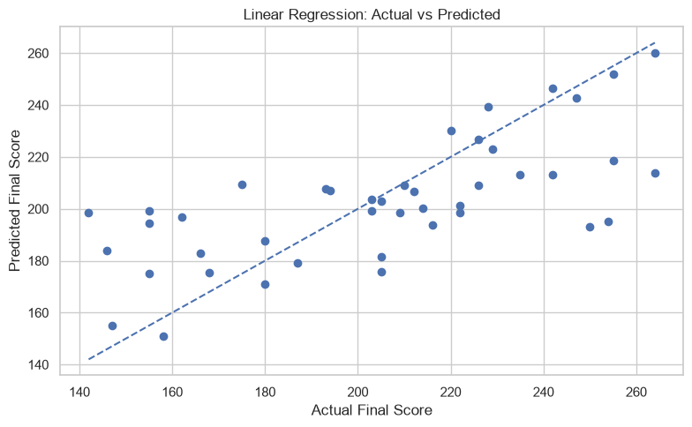


SECTION 03
Experimental Results & Visual Pipeline
CODE TO PLOT EXECUTION
src/plots.py (Core Plotting snippet)
Execution Key
Generated Plot Output
output/PredictedVSActual.png
# 1. Fetch & Execute Notebook Context
exec(full_code, exec_globals) y_test, y_pred = exec_globals['y_test'], exec_globals['y_pred’]
# 2. Render Scatter Plot & Fit Line
sns.scatterplot(x=y_test, y=y_pred, color='#1f77b4', s=65) plt.plot([min_val, max_val], [min_val, max_val], 'r--’)
# 3. Export Figure to Output Folder plt.savefig('output/PredictedVSActual.png', dpi=300)
RENDERS
Full script available in repo
src/main.ipynb
R² SCORE
MEAN ABSOLUTE ERROR
ROOT MEAN SQUARED ERROR
0.48
19.27
25.37
Explains ~55% of score variance
Average deviation in runs
Penalizes larger outliers

Slide 5
SECTION 04
Key Learnings & Team Contributions
PROJECT RETROSPECTIVE
KEY ADVANTAGES
MODEL LIMITATIONS
Linear regression provides immediate interpretability and fast inference without overfitting on small tabular match summaries.
Higher error rates occur during early overs (0–5) due to high variance before innings trajectory stabilizes.
INDIVIDUAL CONTRIBUTIONS
AI-USE DISCLOSURE
Member | Role | Key Ownership
Souvik Das | Docs Lead | Data cleaning script & README structure
Jujhar Singh | Exec Lead | Model training script & GroupSplit logic
Shrinath Dixit | PPT Lead | Plotting notebook & Slide presentation
Randhi Pujitha | Video Lead | Video walkthrough & Demo recording
Gemini was utilized for debugging code paths, resolving Git upload errors, and formatting visual layouts.
✓ All data generation & model training executed independently.

